Slide 1
AI on Google Could
Insight Intelligent Apps Guild

Slide 2

Jeff Cordes
I have been with Insight Digital Innovation since Jan 2018
Architect I – Apps and Infrastructure
Leader of Intelligent Apps Guild with Nick Fahrig and Frank Sikorski
Current Project:
Multi-Cloud Chat (GCP + Azure) Paychex

Slide 3
Democratizing AI

Slide 4

Our mission is to empower every enterprise to transform their business with AI
“
”
- Cloud AI Team

Slide 5
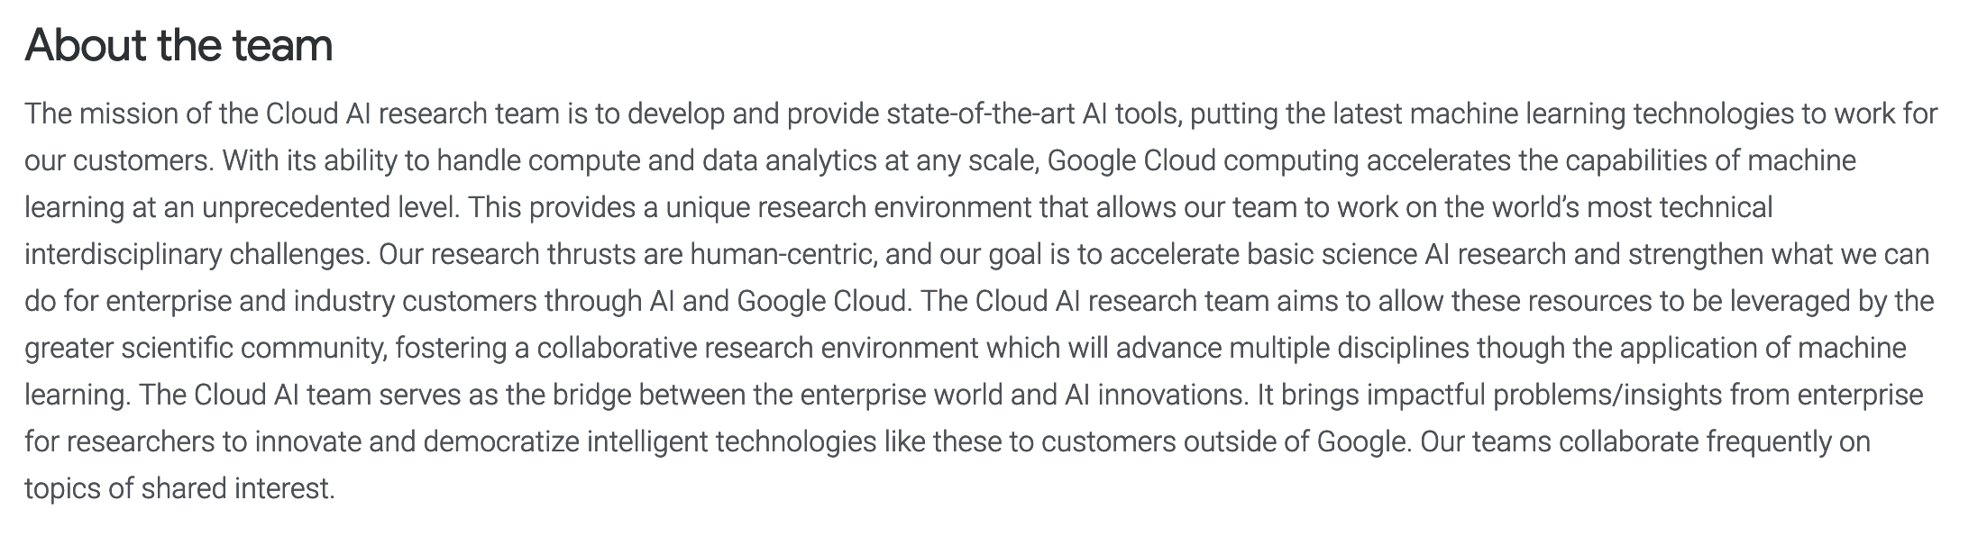

Slide 6
Google Cloud AI Infrastructure

Slide 7
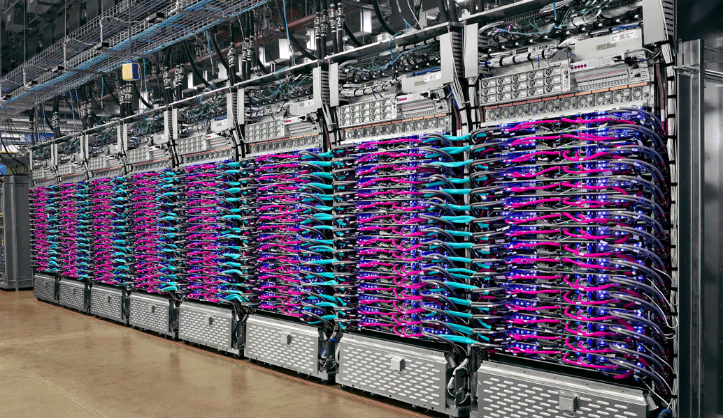
Powered By Tensor Processing Units (TPU)
We built the Tensor Processing Unit (TPU) in order to make it possible for anyone to achieve similar breakthroughs. Cloud TPU is the custom-designed machine learning ASIC that powers Google products like Translate, Photos, Search, Assistant, and Gmail.

Slide 8
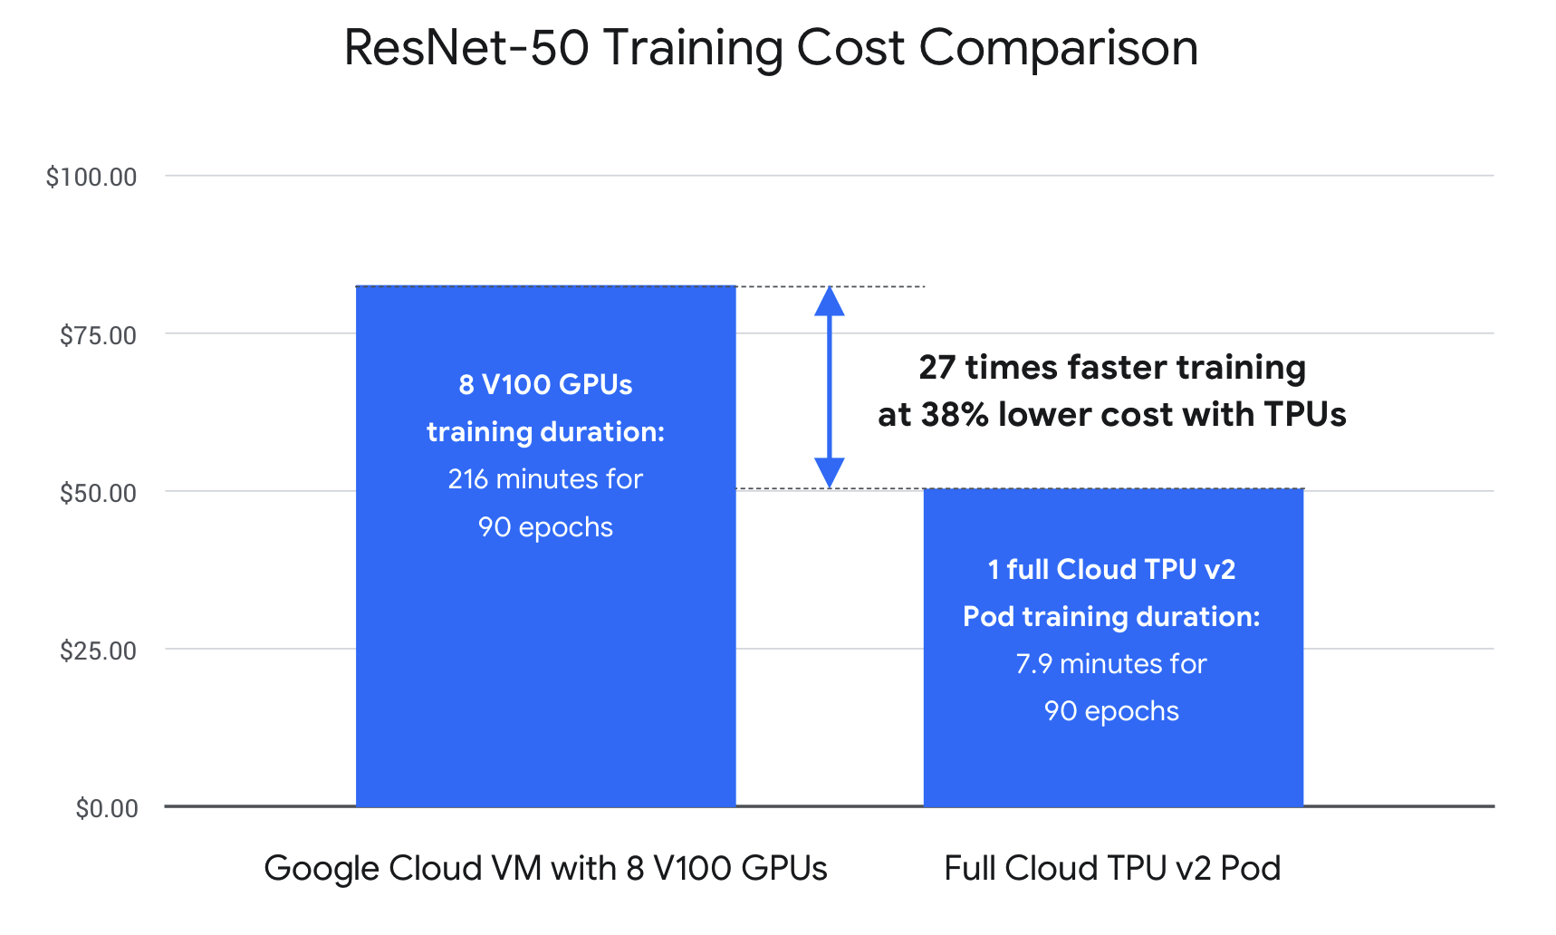
TPU Benchmarks

Slide 9
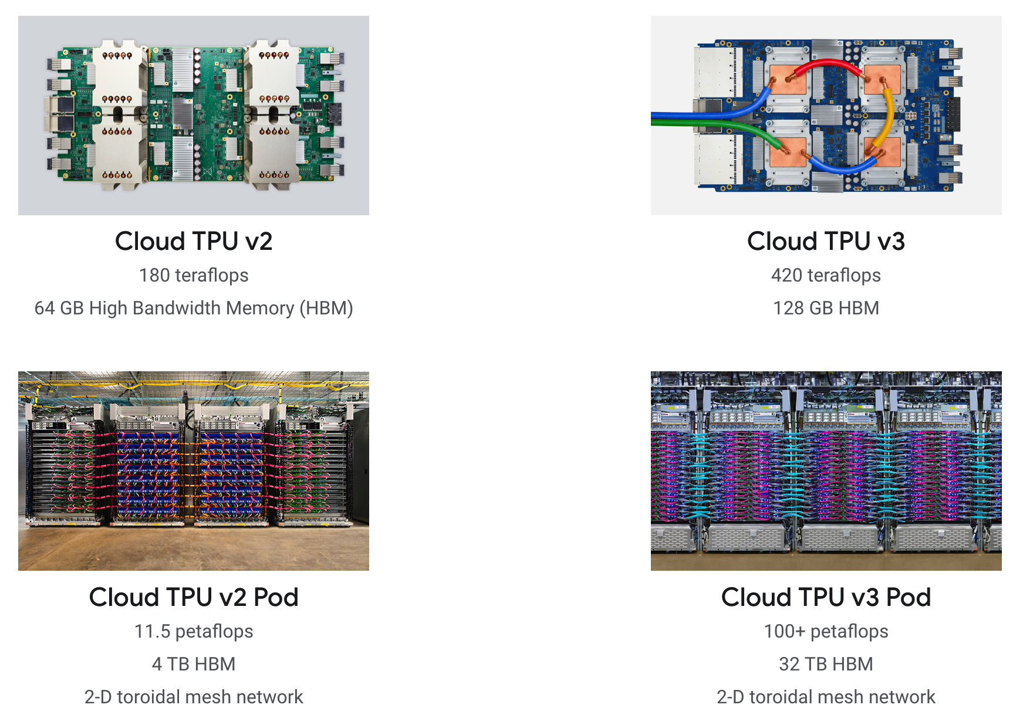
Cloud TPU Offerings

Slide 10
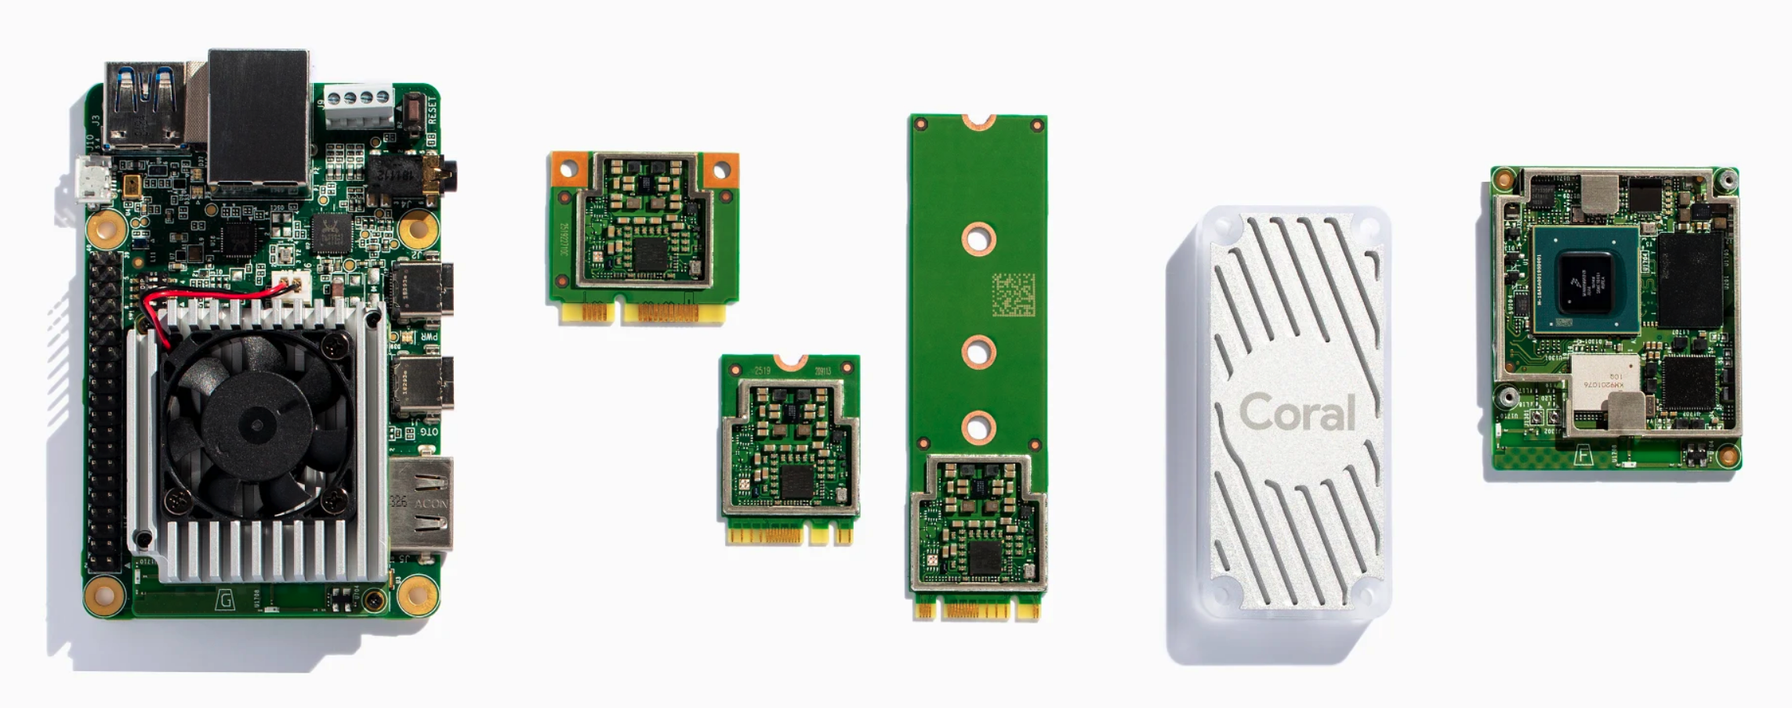
Edge TPU Offerings
Can Run Tensorflow Light and AutoML models on the edge.

Slide 11
Google Cloud AI Tools

Slide 12












Google Cloud AI Tools
Developer Tools
Data Scientist Tools
AI Platform
Tensorflow
AI Building Blocks
Auto ML

Slide 13
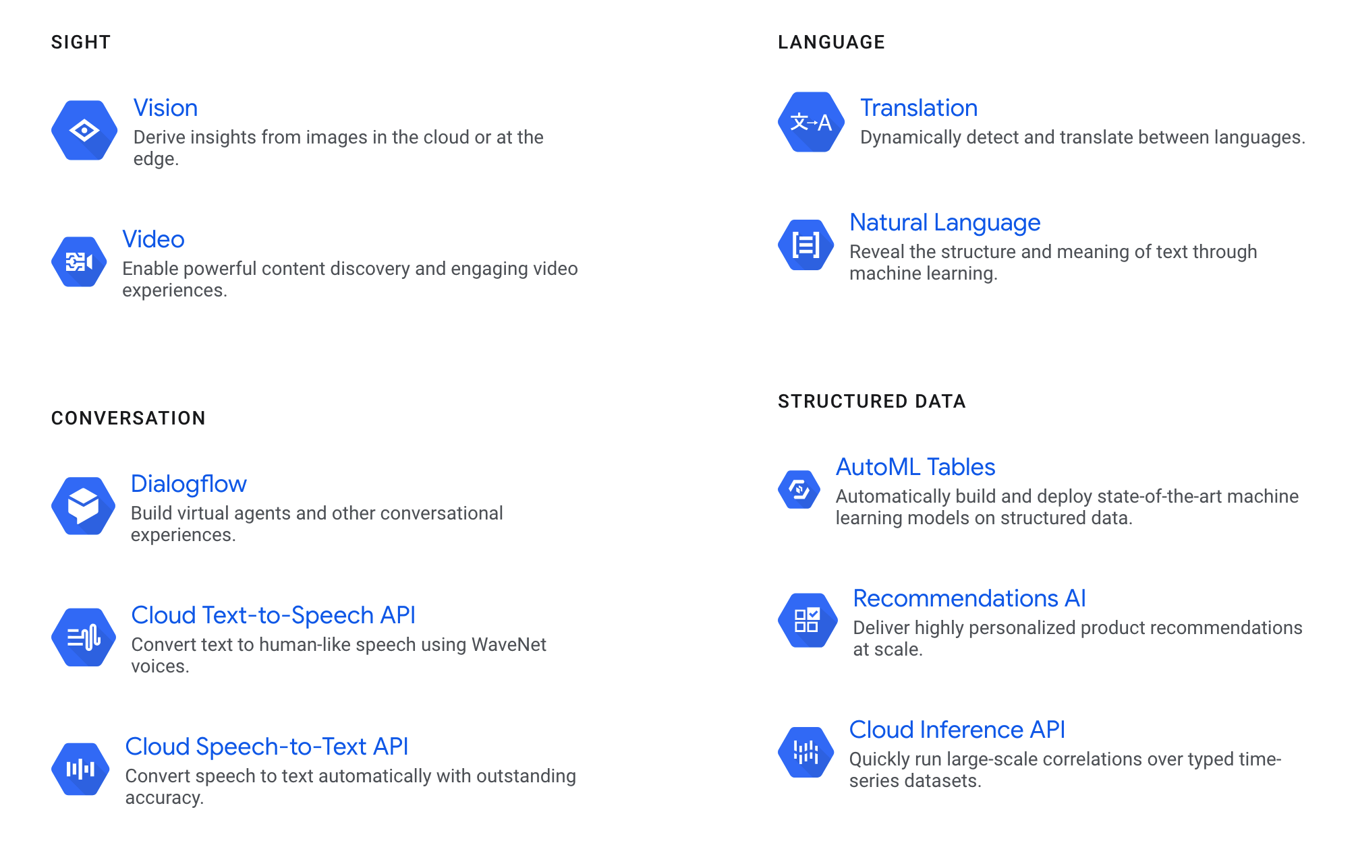

Slide 14
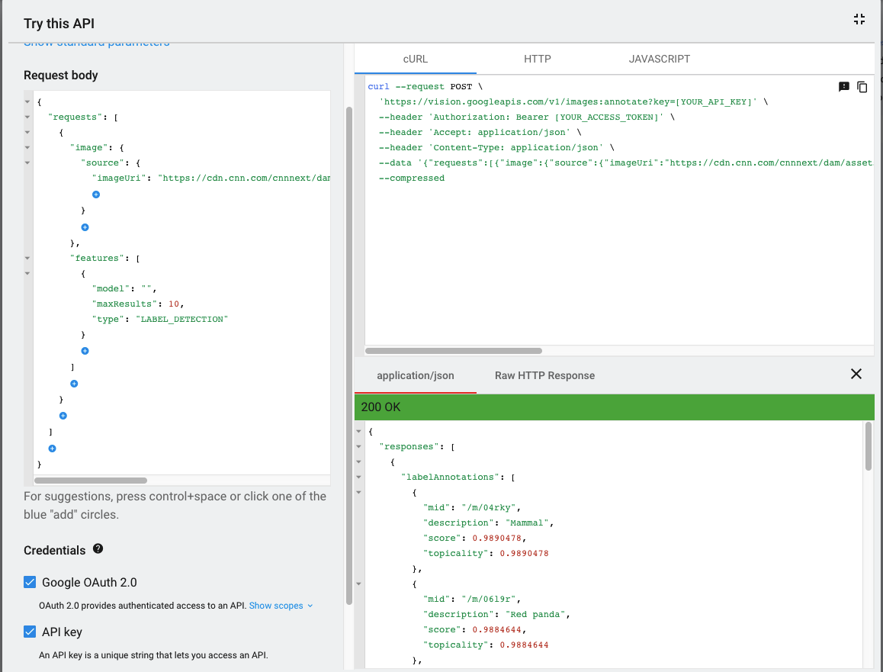
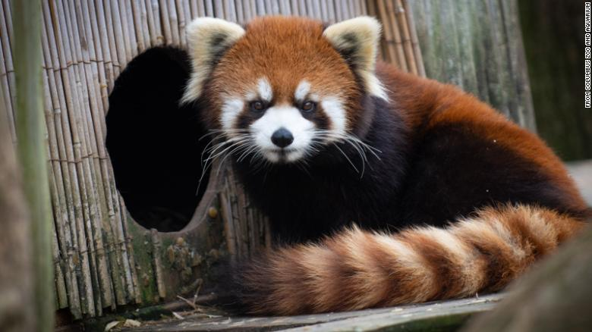
Vision API Example

Slide 15
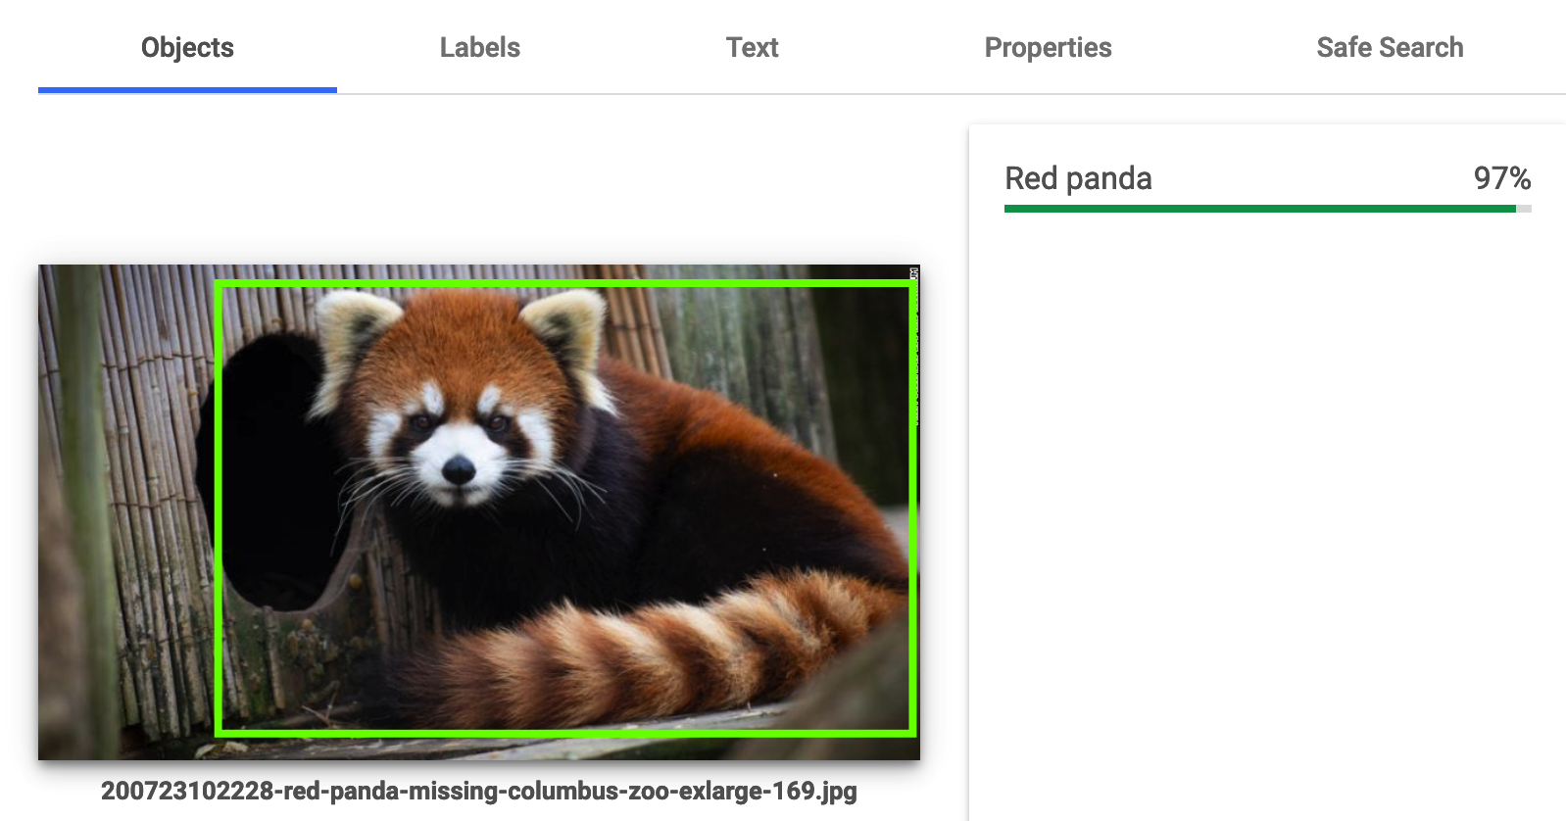
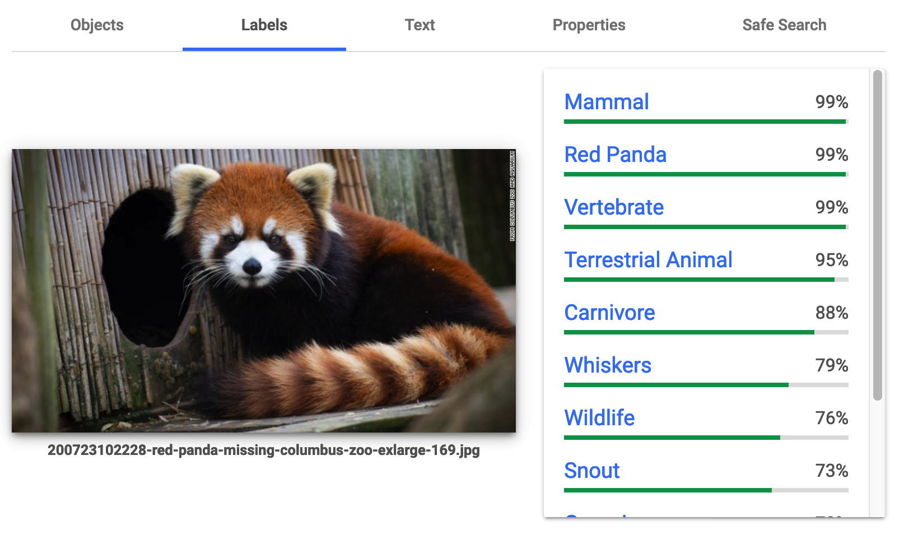
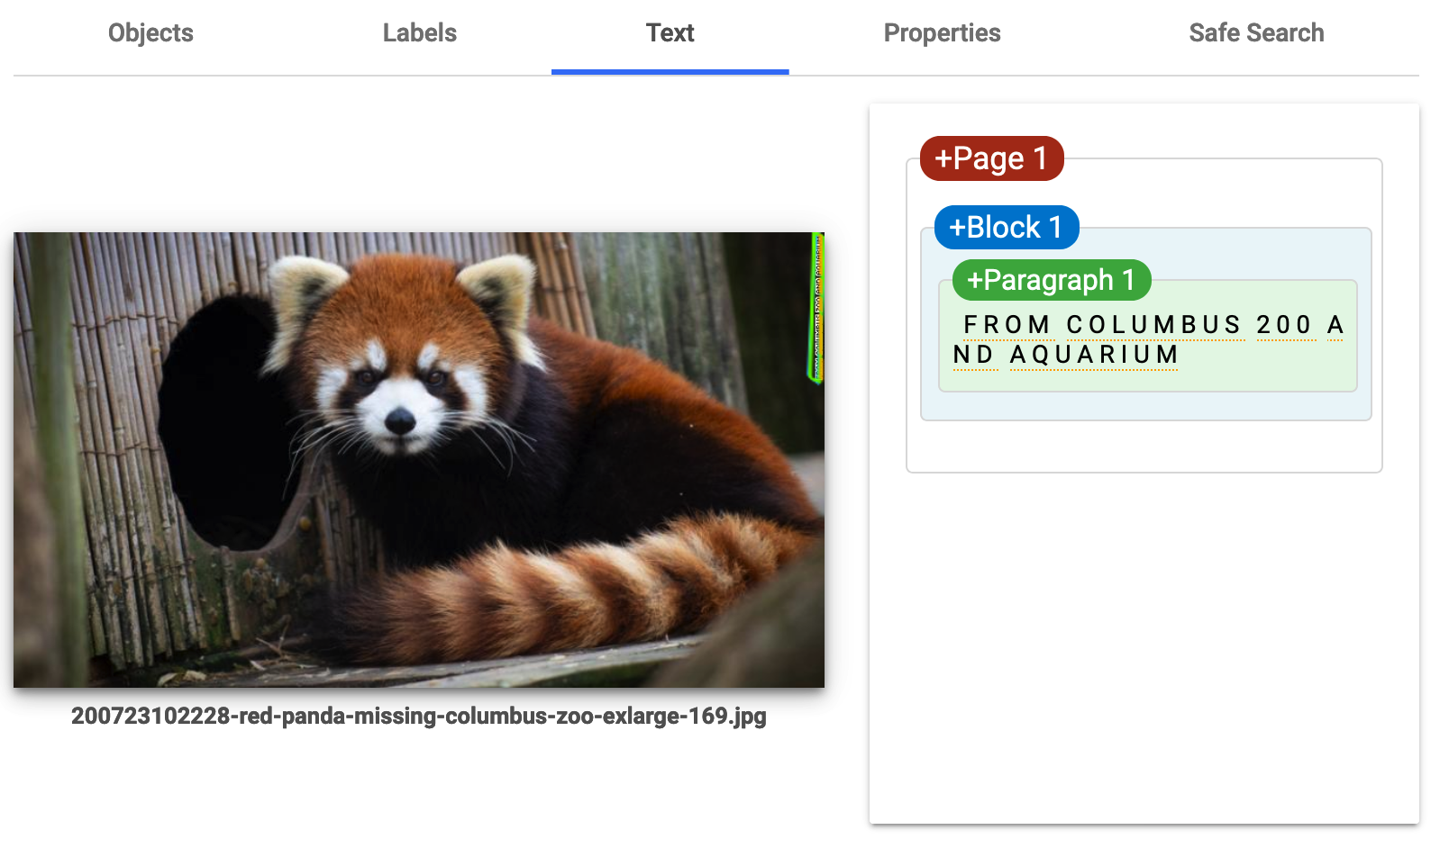
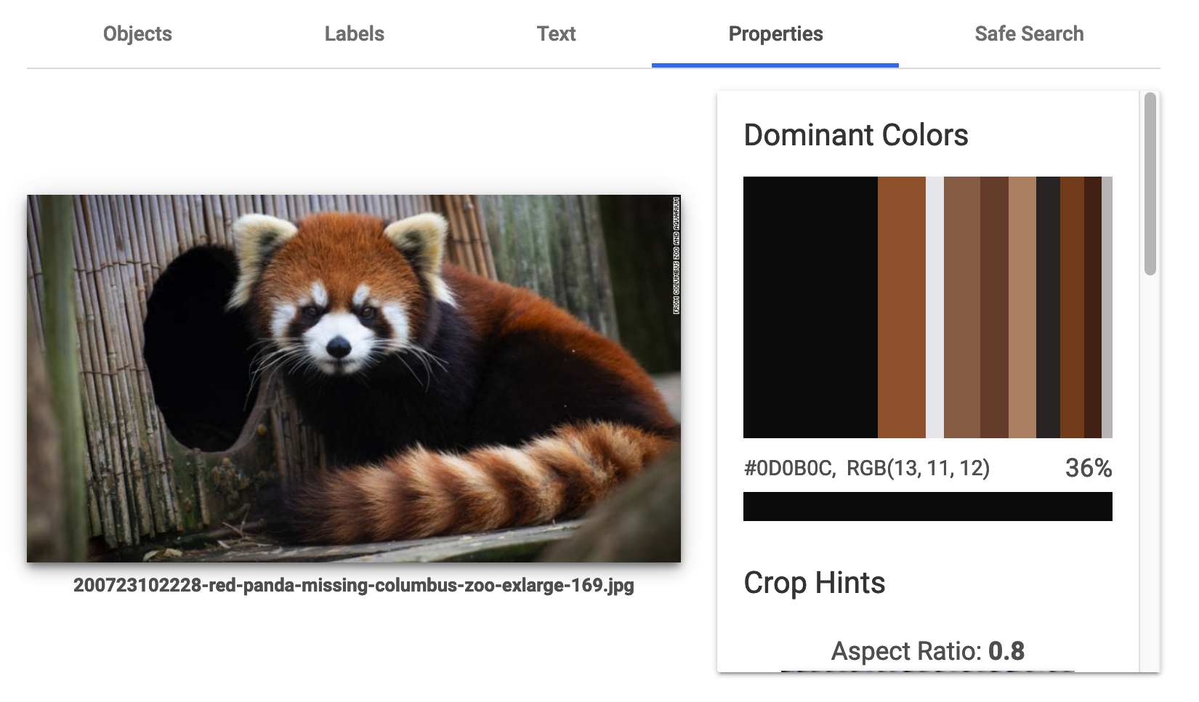
Vision API Results

Slide 16
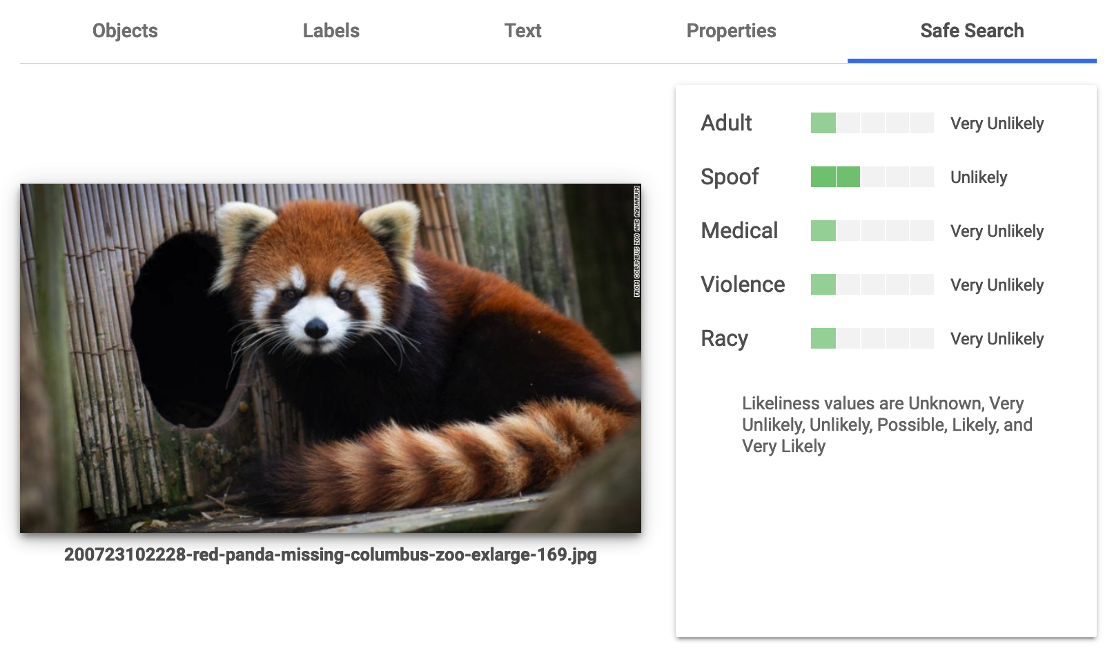

Slide 17
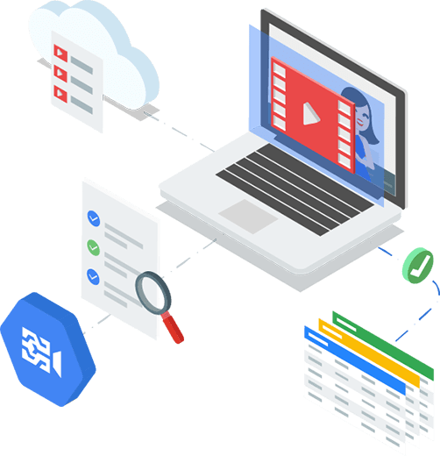
Video Features
Labels (pre-trained only)
Shot Change Detection
Object detection and tracking
Text detection and OCR
Explicit content
Automated Closed Captions (transcribe)
Logo Recognition
Celebrity Recognition (limited access)
Face Detection
Person + pose (Beta)

Slide 18
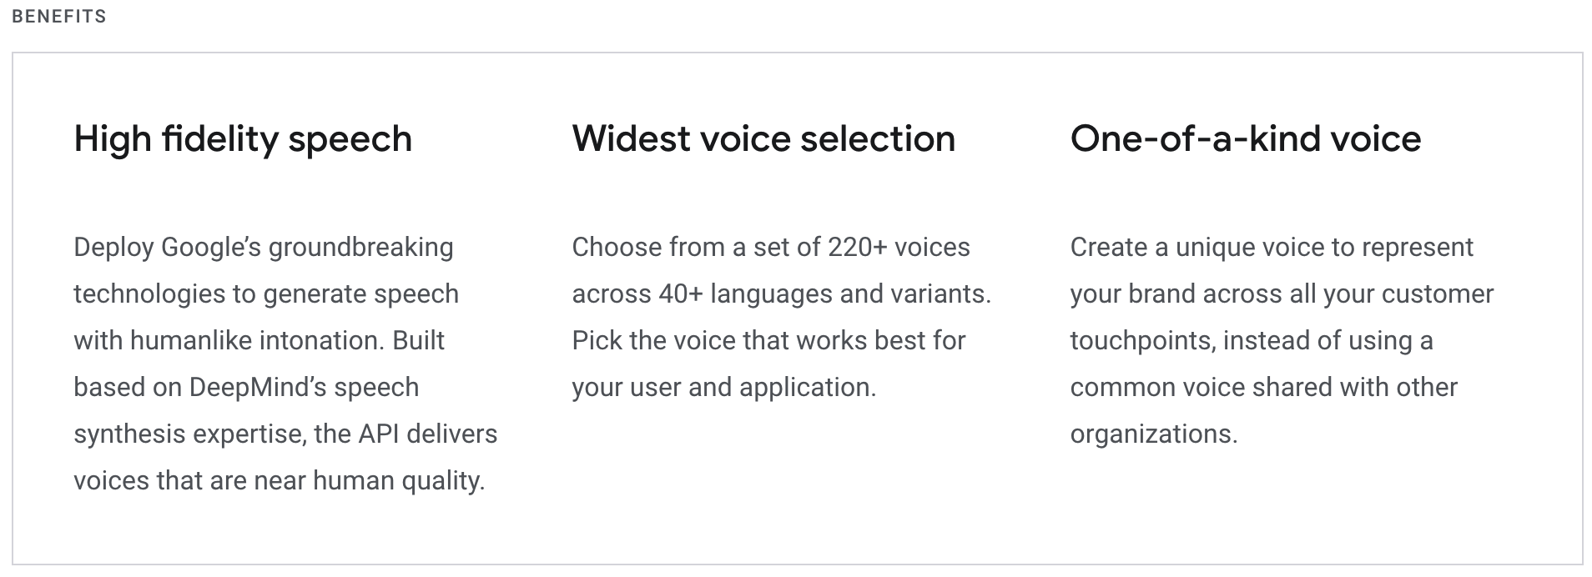
Conversation – Text to Speech
https://cloud.google.com/text-to-speech

Slide 19
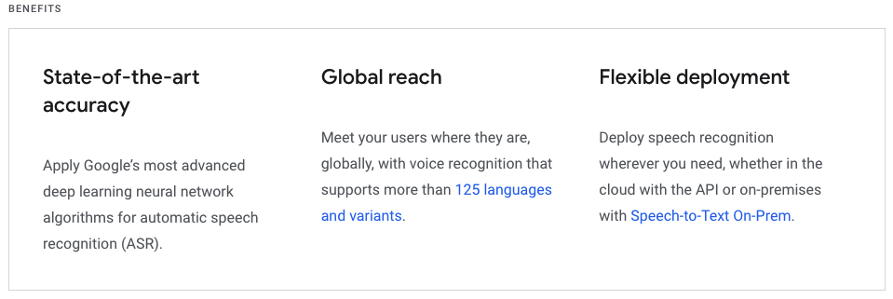
Conversation – Speech to Text

Slide 20
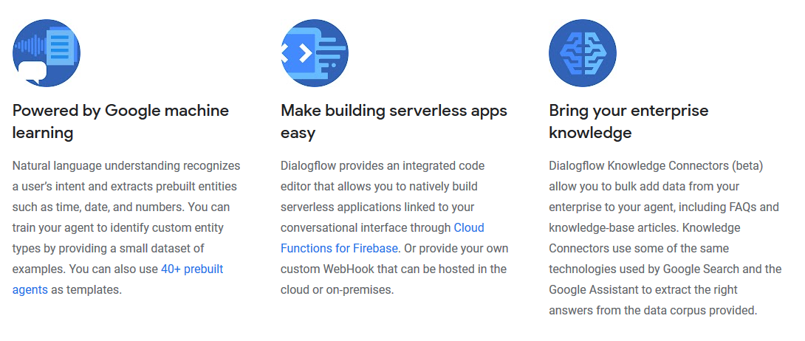
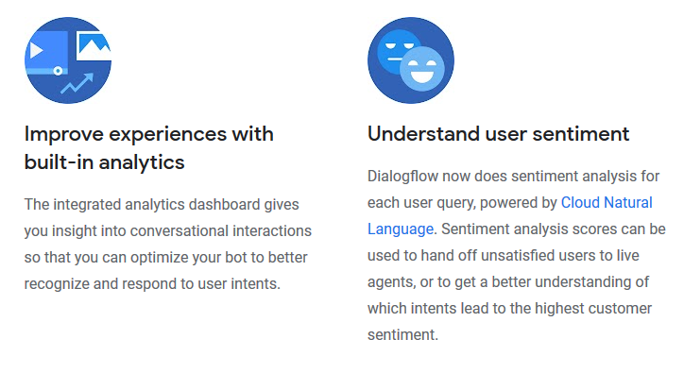
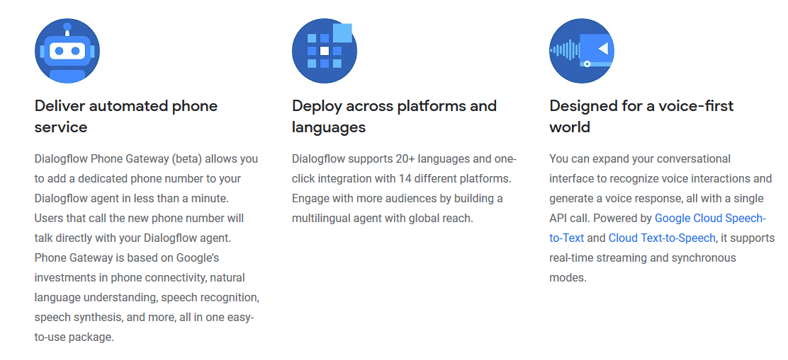
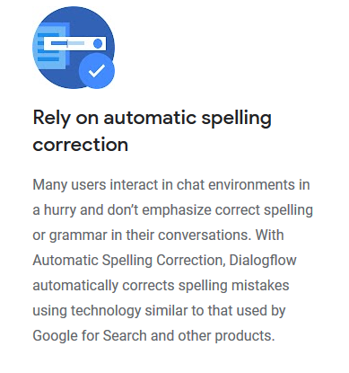
Conversation - Dialogflow

Slide 21
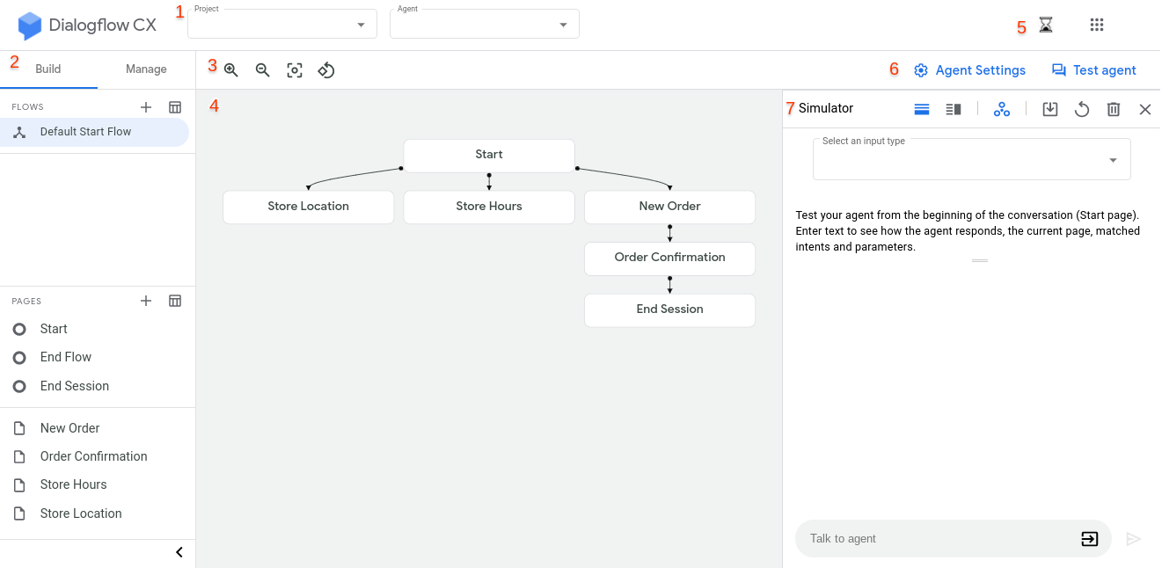
Conversation – Dialogflow CX (Beta)

Slide 22
Language - Translation
Over 50 languages
Language Detection
Translation
Glossary support (brand related content)

Slide 23
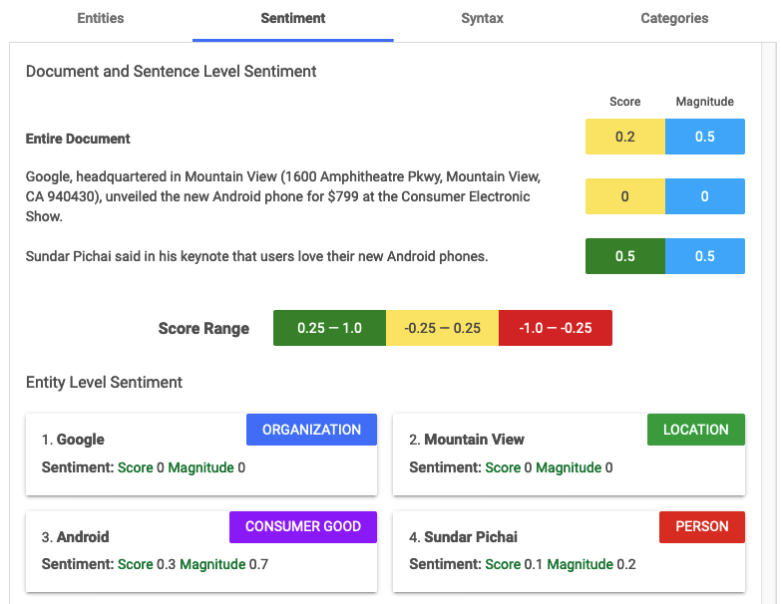
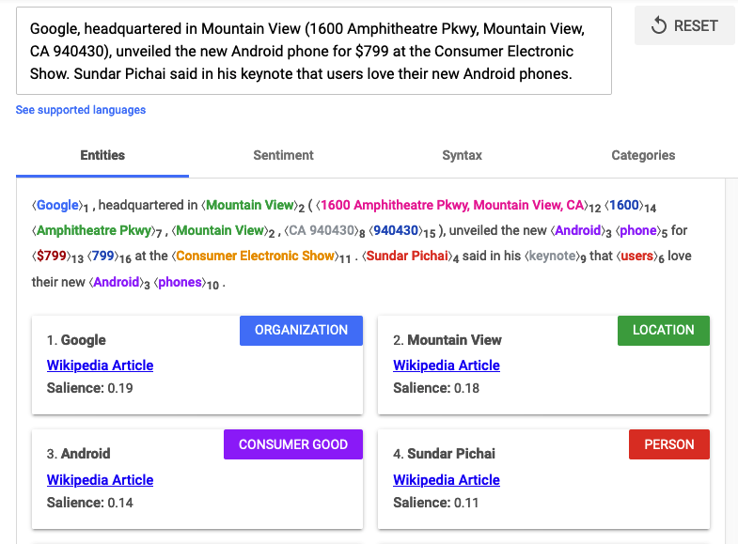
Language - Natural Language

Slide 24
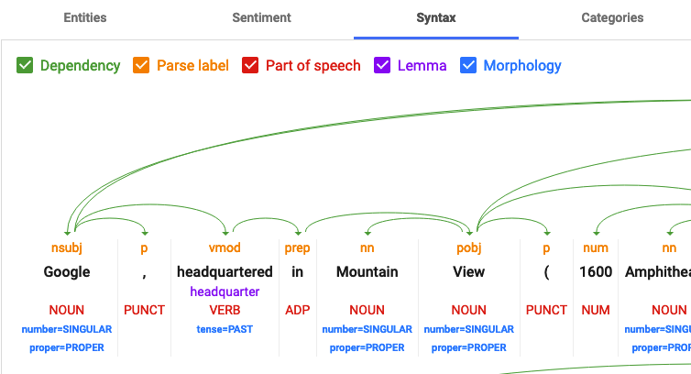
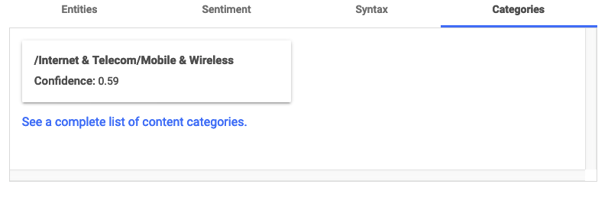
Language – Natural Language

Slide 25
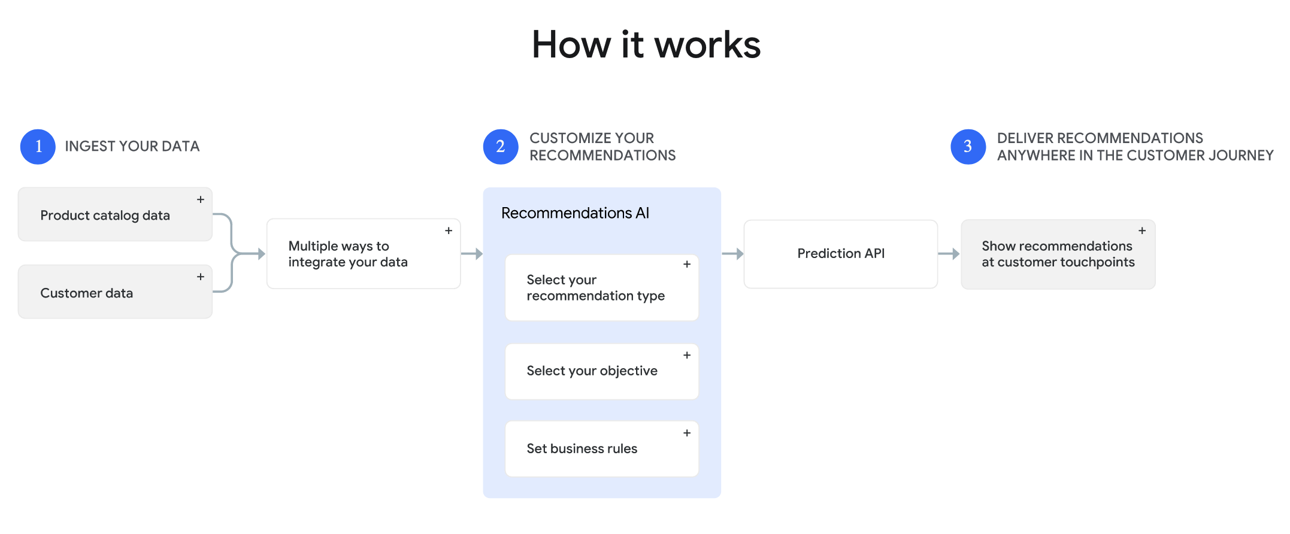
Data - Recommendations

Slide 26
Demo
Setup initial project and IAM in GCP
Jupyter notebooks to use Vision and video inference through python SDK And REST

Slide 27
Auto ML
Create your own custom machine learning models with an easy-to-use graphical interface.

Slide 28
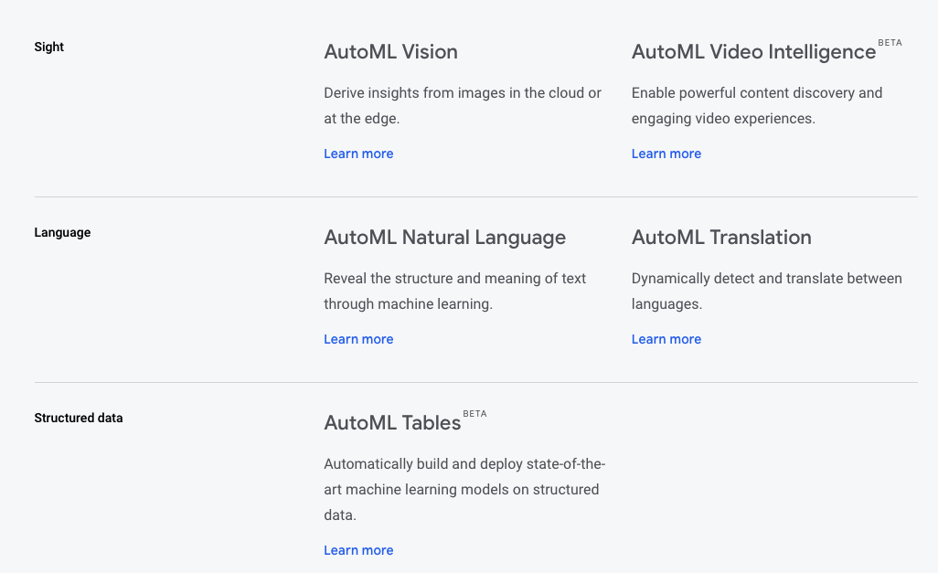

Slide 29
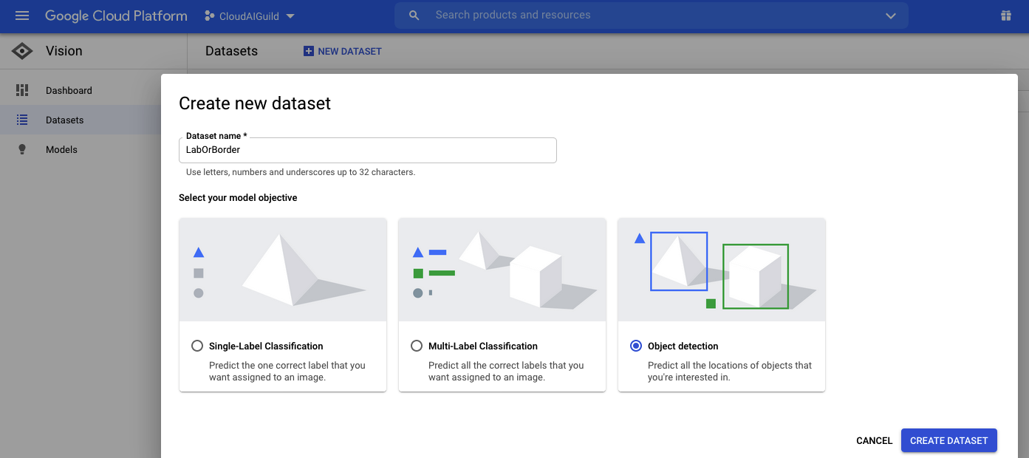
User Interface For Dataset Creation

Slide 30
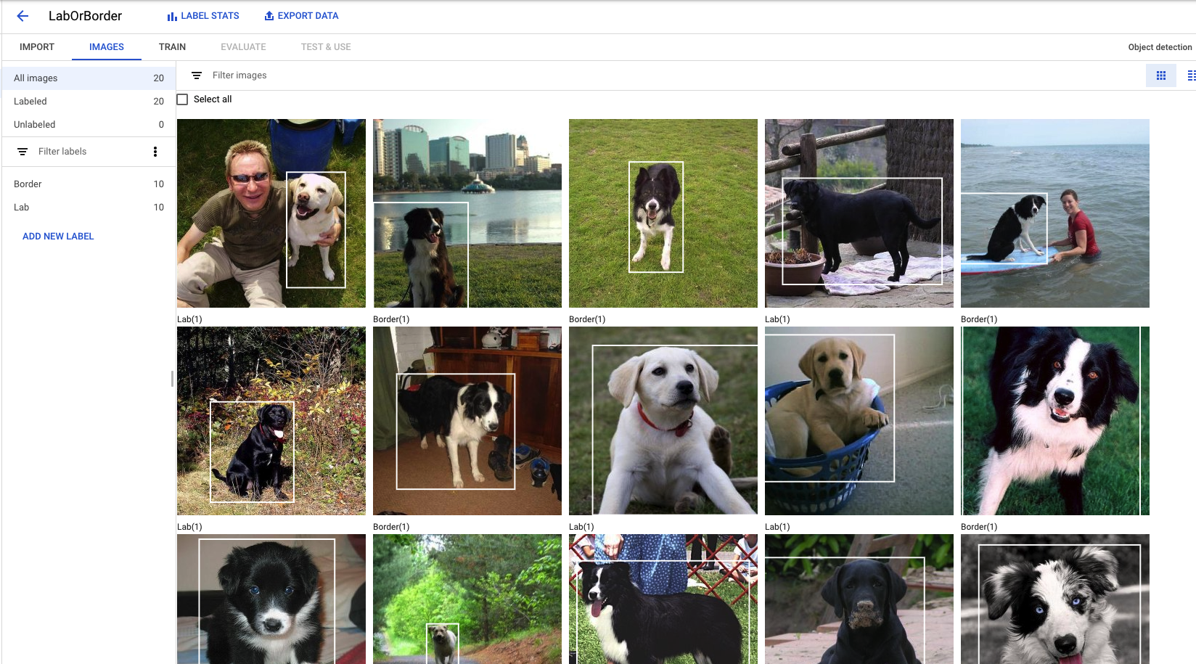
User Interface For Dataset Creation

Slide 31
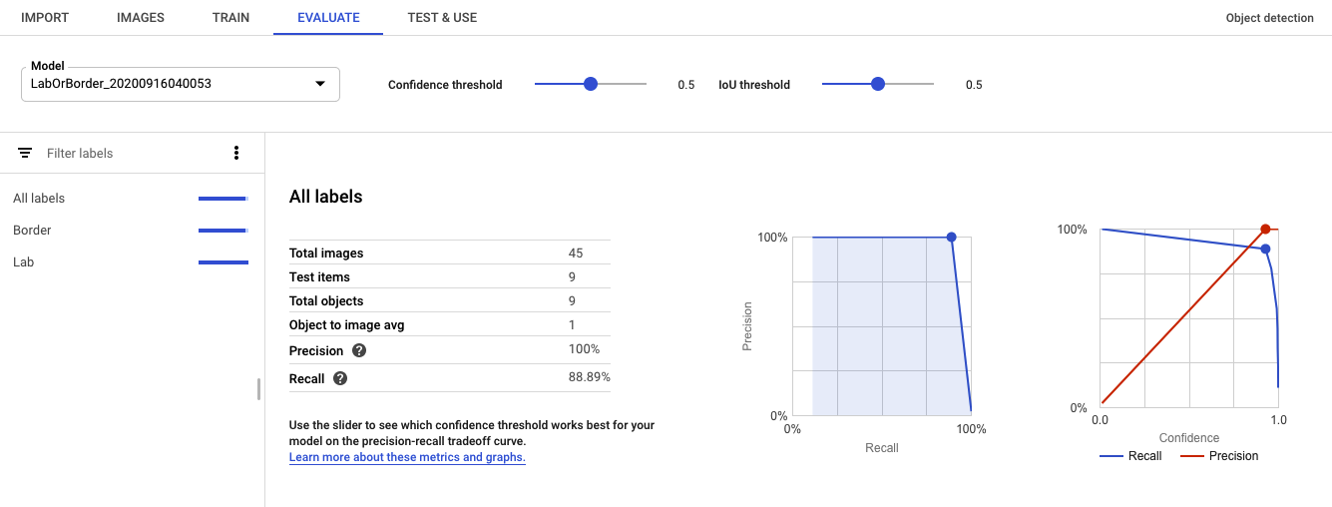
Train and Evaluate

Slide 32
Image classification training costs
The cost for AutoML Vision Image Classification model training is $3.15 per node hour.
For each unit of time, we use 8 nodes in parallel, where each node is equivalent to a n1-standard-8 machine with an attached NVIDIA® Tesla® V100 GPU. See Table below*.
The time required to train your model depends on the size and complexity of your training data. Many customer find that 8 node hours (approximately 1 "wall clock" hour) is sufficient to build an experimental model. Additional training time increases accuracy to a production level. The early stopping feature ensures that training stops when further accuracy improvement is not possible.
You pay only for the compute hours used; if training fails for any reason other than a user-initiated cancellation, you will not be billed for the time. You will be charged for training time if you cancel the operation.
Training example
Example 1 - Cloud model with resumable training
You trained a Cloud Image Classification model for experimental use with 40 node hours, and two days later spent 16 node hours of resumable training to get it ready for production use.
You will receive a bill that shows:
($3.15 per node hour) * (40 node hours) = $126.00 for the initial training
($3.15 per node hour) * (16 node hours) = $50.40 for the resumable training

Slide 33
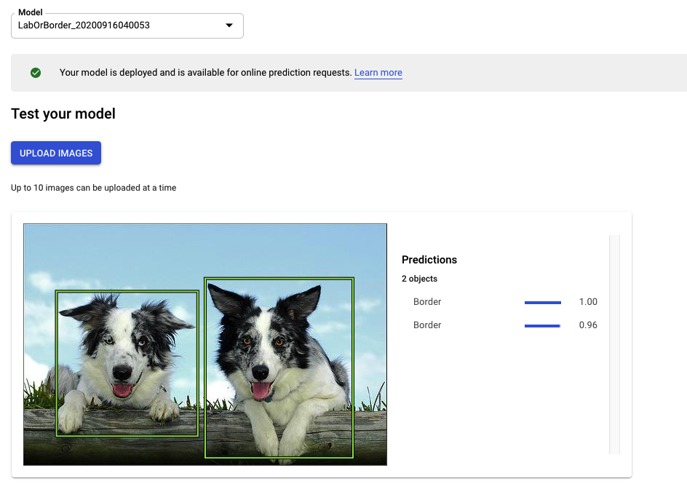
Inference on trained model

Slide 34
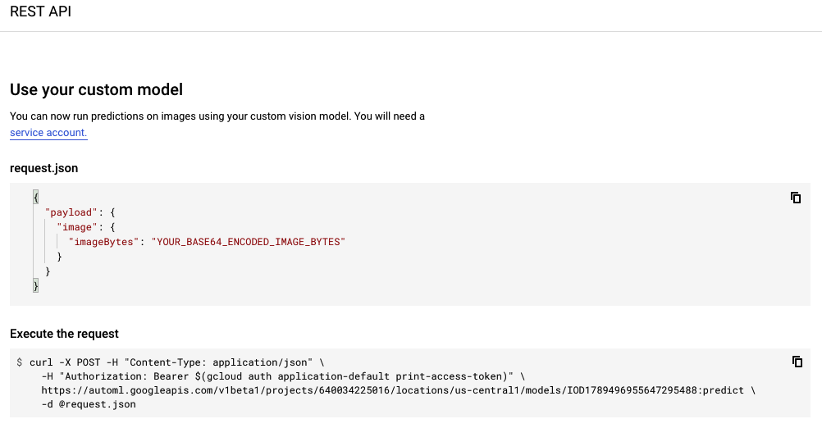
Code examples of model use

Slide 35
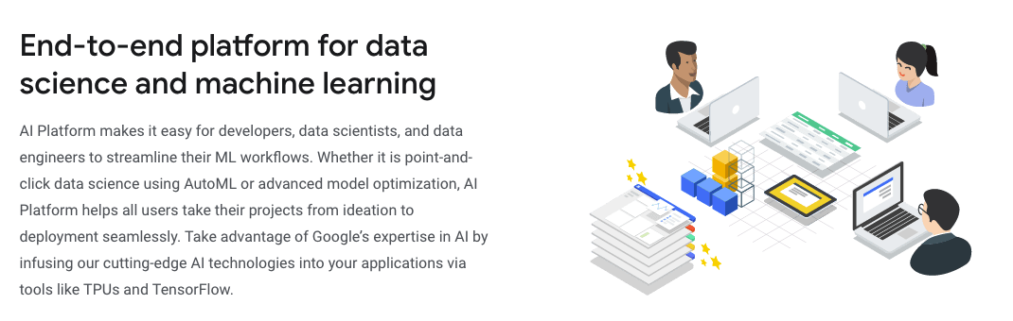
AI Platform

Slide 36
AI Platform Services
Prepare
BigQuery DataSets
Data Labeling Service
Build
AutoML
AI platform notebooks
AI platform training
Validate
Explainable AI
AI Platform Vizer
Deploy
AI platform prediction
AutoML Edge
Tensorflow Enterprise
ML Ops
AI Platform pipelines
Continuious evaluation
Deep Learning VM
Deep Learning Containers

Slide 37
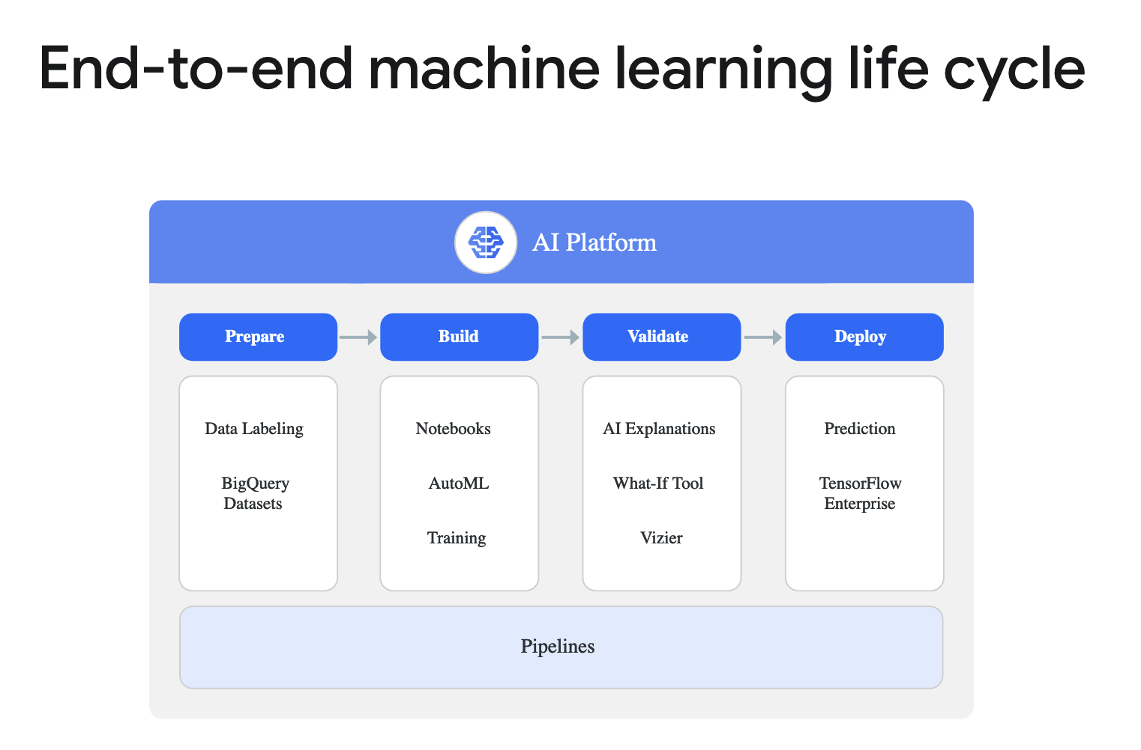

Slide 38
Questions

